Slide 1
Analysis of Appointment Scheduling Dataset
Presented by: Sharmaine Wong
Ministry of Health

Slide 2


Overview of Dataset
Includes information of patients, requesting and appointment dates, and provider roles
Data from week of September 20 – November 9, 2023
Importance of Waiting Times
Timely access and availability are significant aspects of an effective healthcare system
Longer wait times are linked to worsening health outcomes
Effective management needed to minimize wait times, improving patience experience and health conditions
Objective: To provide recommendations based on average wait time data analysis

Slide 3
Data Cleaning Process and Insights
Cleaning Data with Power Query
Trim: Additional spaces removed from Patient names
Full Name: new merged column for Full Name of Patients
Transformed column types: Text, Date, Number format
Insights
Improvement areas: spaces, data entry validation to reduce errors
Client ID: ensure unique IDs are allocated to each patient and not the same person
Clarity needed for the usage of Client ID: not an unique identifier for each patient
Approach to Handing Missing Data
Inconsistent “0” values in Client IDs
Implement client and appointment IDs
Client IDs aren’t unique to the patient and cause confusion whether duplicate patient names are the same person or not
Incorporate data entry validation for IDs and Patient Names
Impact of Missing Data
Lead to inaccurate and misleading analysis of waiting times
Wrong person with the same name may show up at the appointment

Slide 4


Slide 5
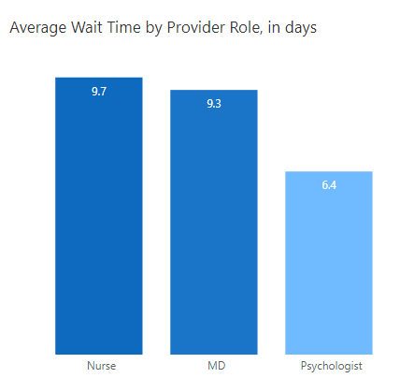
Average Wait Time by Provider Role
Observations
01
Nurse and MDs have the highest average waiting time since requesting date.
02
MDs have double the number of appointments than Nurses.
03
Psychologists have the lowest average waiting time and patients.
04
Hiring additional and on-call MDs & Nurses is suggested to reduce burden.

Slide 6
Recommendations
Addressing Highest Wait Times
On average, Nurses and MDs have the highest wait times
Addressing High Amount of Patients
MDs have the highest amount of patients, meaning there may be higher needs for staffing
Data quality improvement areas
Differentiation made between a Client and Appointment ID
Additional funding, staffing, or equipment to improve efficiency in providing services
Highest priority is to staff more MDs, as wait time for both are same (number of patients MDs have are double of a nurse)
Further data identification inputs to consider: Age, Gender, Location, Provider Names

